Slide 1

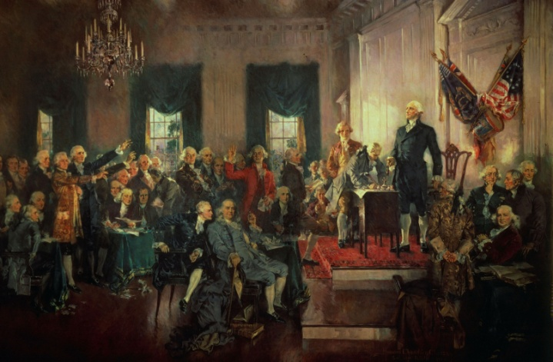
Confederation to Constitution,
1776–1791
The Articles of Confederation prove inadequate to govern the new nation. U.S. delegates create the Constitution and, after much debate, it is ratified.
Signing of the U.S. Constitution on September 17, 1787. Oil (1940), Howard Chandler Christy.
NEXT

Slide 2
Confederation to Constitution,
1776–1791
SECTION 1
The Confederation Era
SECTION 2
Creating the Constitution
SECTION 3
Ratifying the Constitution
NEXT

Slide 3

Section 1
The Confederation Era
The Articles of Confederation were too weak to govern the nation after the war ended.
NEXT

Slide 4
SECTION
The Confederation Era
1
Moving West
• Settlers mainly travel on Wilderness Road into Kentucky
Image
• Tensions between settlers and Native Americans lead to conflicts
• By 1790s, about 100,000 Americans live in Kentucky region
NEXT

Slide 5
SECTION
1
New State Governments
• After independence, each state creates its own government
• Some states set up governmental branches to limit power of government
• Some states include a bill of rights to help control government
• All state governments are republics—people choose representatives
NEXT

Slide 6
SECTION
1
The Articles of Confederation
• Articles of Confederation—plan for national government
• Gives national government few powers
• Can make war, make peace, sign treaties, issue money
• Each state has 1 vote in Congress
• States have important powers like setting taxes, enforcing laws
Continued . . .
NEXT

Slide 7
SECTION
1
continued The Articles of Confederation
• Continental Congress passes Articles of Confederation in 1777
• In 1778, 8 states ratify, small states refuse to sign
• Large states with Western lands have advantage in paying debts
• All states give up Western lands, articles are ratified in 1781
NEXT

Slide 8
SECTION
1
The Northwest Ordinance
• Land Ordinance of 1785 divides Western lands into townships
Map
• Lands known as the Northwest Territory
• Northwest Ordinance (1787) describes how territory is governed:
- rules for attaining self-government,
statehood
- conditions for settlement
- outlaws slavery
- freedom of religion
- trial by jury
NEXT

Slide 9
SECTION
1
Weaknesses of the Articles
• Revolutionary War leaves U.S. government with huge debts
• Articles of Confederation do not give Congress power to raise taxes
Chart
• States provide Congress with little tax money
• Congress unable to pay soldiers, soldiers riot
NEXT

Slide 10
SECTION
1
Shays’s Rebellion
• Mid-1780s Massachusetts people pay high taxes, many have little money
• Many farmers cannot pay debts, property is auctioned
• If auctioned property does not pay debts, farmer is put in prison
• Group of men, led by Daniel Shays,
rebel—Shays’s Rebellion
Image
• Rebellion is subdued, emphasizes that government needs reform
NEXT

Slide 11
Section 2
Creating the Constitution
The states sent delegates to a convention to solve the problems of the Articles of Confederation.
NEXT

Slide 12
SECTION
Creating the Constitution
2
A Constitutional Convention Is Called
• Delegates from 5 states meet to create national trade laws
• Call for national meeting in Philadelphia
• Afraid of rebellion, 12 states (except Rhode Island) send delegates (1787)
NEXT

Slide 13
SECTION
2
The Convention’s Delegates
• 55 state delegates meet at Constitutional Convention in Philadelphia
• Delegates include George Washington, Benjamin Franklin
• One of the ablest delegates is James Madison
Image
• Delegates do not include Native Americans, African Americans, women
NEXT

Slide 14
SECTION
2
The Delegates Assemble
• Delegates want to create government strong enough to maintain order
• But also want government that protects people’s rights
NEXT

Slide 15
SECTION
2
The Convention Begins
• George Washington elected president of the Constitutional Convention
Image
• Delegates do not want decisions influenced by political pressures
• To ensure this, they decide that discussions will remain secret
NEXT

Slide 16
SECTION
2
The Virginia Plan
• The Virginia Plan divides government into 3 branches:
- legislature makes the laws
- executive enforces the laws
- judiciary interprets the laws
Interactive
• Legislature has two houses
• Representation is based on each state’s population or wealth
• Larger states support plan, smaller states oppose
• Smaller states are afraid larger states will control them
NEXT

Slide 17
SECTION
2
The Great Compromise
• New Jersey Plan is an alternative plan for U.S. government:
- legislature has one house
- each state has one vote
• Delegates vote for the Virginia Plan over the New Jersey Plan
Chart
• Delegates pass the Great Compromise
• Each state is given equal votes in senate:
- satisfies the smaller states
• State’s population determines representation, House of Representatives
- satisfies the larger states
NEXT

Slide 18
SECTION
2
Slavery and the Constitution
• Southern states want slaves counted for representation, not for taxes
• Northern states want slaves counted for taxes, not for representation
• To solve dispute, delegates agree to the Three-Fifths Compromise:
- 3/5 of slave population counts for direct
taxes
- 3/5 of slave population counts for
representation
• Debate, delegates agree slave trade cannot be banned until 1808
NEXT

Slide 19
SECTION
2
Regulating Trade
• Delegates place few limits on Congress’s power to regulate commerce
• Southerners succeed in banning Congress from taxing imports
• Native Americans are not foreign nations or part of separate states
• On September 15, 1787, delegates approve the Constitution
Image
• Constitution sent to the states for ratification
NEXT

Slide 20
Section 3
Ratifying the Constitution
Americans across the nation debated whether the Constitution would produce the best government.
NEXT

Slide 21
SECTION
Ratifying the Constitution
3
Federalists and Antifederalists
• Supporters of the Constitution claim that it is based on federalism
Interactive
• Federalism—power is shared between central government, states
• People who support the Constitution are called Federalists
• People who oppose the Constitution are called Antifederalists
• Afraid Constitution takes too much power from states
• Also feel that Constitution does not guarantee rights for the people
NEXT

Slide 22
SECTION
3
The Federalist Papers
• Federalists write essays, answer Antifederalists’ attacks
• Best-known essays are The Federalist Papers
• Authors are James Madison, Alexander Hamilton, John Jay
Image
• Appeal to people’s reason and emotion
NEXT

Slide 23
SECTION
3
The Battle for Ratification
• June 1787, 9 states ratify Constitution, New York, Virginia yet to vote
• New York, Virginia influential states, Federalists want their support
• Virginian George Mason opposes ratification until bill of rights added
Image
• James Madison also suggests bill of rights, Virginia, New York ratify
• Rhode Island is last state to ratify (1790)
NEXT

Slide 24
SECTION
3
The Bill of Rights
• States ask that the Constitution include a bill of rights
• James Madison makes list of changes, or amendments, to Constitution
• Congress edits amendments, puts them at the end of the Constitution
• In 1791, states ratify 10 amendments, known as Bill of Rights
NEXT

Slide 25
This is the end of the chapter presentation of
lecture notes. Click the HOME or EXIT button.
NEXT

Slide 26



Print Slide Show
1. On the File menu, select Print
2. In the pop-up menu, select Microsoft PowerPoint
If the dialog box does not include this pop-up, continue to step 4
3. In the Print what box, choose the presentation format you want to print: slides, notes, handouts, or outline
4. Click the Print button to print the PowerPoint presentation
Print Text Version
1. Click the Print Text button below; a text file will open in Adobe Acrobat
2. On the File menu, select Print
3. Click the Print button to print the entire document, or select the pages you want to print
Print Text
Print Text
BACK

